Slide 1



Project proposal
R E S T A U R A N T
R E C O M M E N D A T I O N B A S E D O N F E A T U R E S

Slide 2





B. P. PODDAR INSTITUTE OF MANAGEMENT & TECHNOLOGY Department of Computer Science & Engineering (CSE)
PROJECT TOPIC: Restaurant Recommendation Based on Features
Subject Name & Code: Project II
Semester: 8th Semester, 2023
Presented by:
Presented By :
Moumita Basak
Hrishabh Mukherjee
Debjit Kundu
11500120035
115001200314
11500120064

Slide 3




T H E P R O B L E M W E A R E T R Y I N G T O S O L V E
1 2 3
Problem 1
What restaurant will have the cuisine that we want (Single/multiple types of cuisine)
Problem 2
What restaurant will be budget friendly
Problem 3
What restaurant will provide the option of dine-in or takeout
This is the problem we are trying to solve

Slide 4

Motivation
The application that we are proposing will check the dataset of 5000 restaurants in Kolkata. Our application will provide the 5 recommended restaurants in a single click of the “Recommend Restaurant” button.

Slide 5





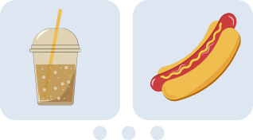
Related work
1. Comparing Filtering Techniques in Restaurant Recommendation System Author : Nanthaphat Koetphrom, Panachai
Charusangvittaya and Daricha Sutivong]
2. Impact of Feature selection on content-based recommendation system
Author : Yassine Afoudi , Mohamed Lazaar and Mohamed Al Achhab

Slide 6


Preprocessing
Methodology
Developing ML Model
Web interface for the user

Slide 7


Dataset resources used
Restaurant Database
This tabular dataset consists of almost all restaurants in Kolkata. https://www.kaggle.com/datase ts/vora1011/zomato-kolkata- restaurants-2022

Slide 8

Name of the restaurants
Zomato URL of the restaurants
Attributes covered :
Cuisines
Ratings
Complete address of the restaurants
Contact number of the restaurants
Is Home Delivery service available?
Average Cost

Slide 9
Algorithms Used for Data Preparation
TF-IDF Vectorizer
TF-IDF (Term Frequency-Inverse Document Frequency) vectorizer is a commonly used technique for converting a collection of text documents into numerical feature vectors. It aims to capture the importance of words in a document relative to a larger corpus.

Slide 10
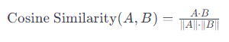
Algorithms Used Model Engineering
Cosine Similarity
Cosine similarity is a measure of similarity between two vectors in an inner product space. The cosine similarity essentially measures the cosine of the angle between the vectors. When the vectors are identical, the angle is 0 degrees, and the cosine similarity is 1.

Slide 11
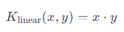
Algorithms Used Model Engineering
Linear Kernel
A linear kernel is a type of kernel function used in machine learning, particularly in support vector machines (SVMs). A kernel function is a mathematical function that computes the similarity (or inner product) between two vectors in a higher-dimensional space by computing the dot product. The linear kernel considers both the direction and magnitude of vectors

Slide 12
Algorithms Used Model Engineering
Euclidean distance Metrics
In the context of machine learning and data analysis, Euclidean distance is often used as a similarity measure or a dissimilarity measure between data points, especially in clustering algorithms, nearest neighbor search algorithms, and in dimensionality reduction techniques like principal component analysis (PCA).
The formula for Euclidean Distance (2-D):
d = [(x₁ – y₁ )²+ (x₂ – y₂)²]^{1/2}

Slide 13
Algorithms Used Model Engineering
Manhattan distance Metrics
It is the sum of the absolute differences of the coordinates between the two points. Unlike the Euclidean distance, which measures the shortest straight-line path between two points, the Manhattan distance measures the shortest path that can be taken along the grid lines, which only allows movement horizontally or vertically (not diagonally).
Mathematical Formula 2-D
d = |x₁ – y₁| + |x₂ – y₂|

Slide 14
Method used for Testing and Evaluation
User feedback testing: AB Testing
User feedback testing is a process used by companies and organizations to gather feedback from users about their products, services, or experiences. This feedback is then analyzed and used to make improvements or changes based on the users' preferences, needs, and pain points.
In this project, feedback is collected from multiple users and then a conclusion is derived on which model performs best for the most number of uses. For Recommendation systems, AB testing or user feedback testing is used widely in the industry

Slide 15
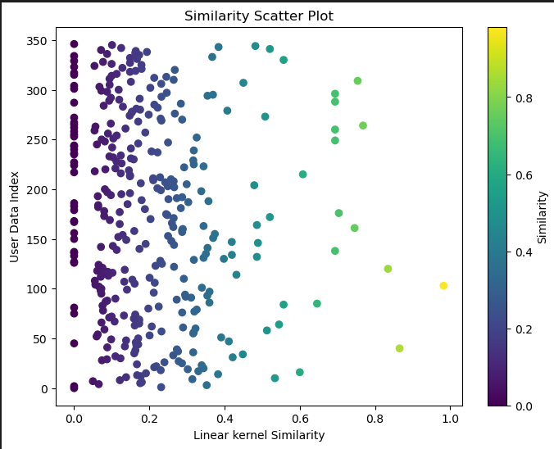
Result of recommendation
User’s Choice
Cuisine: South Indian
Features: Homedelivery
Cost Category: Midrange
Area: New Town

Slide 16

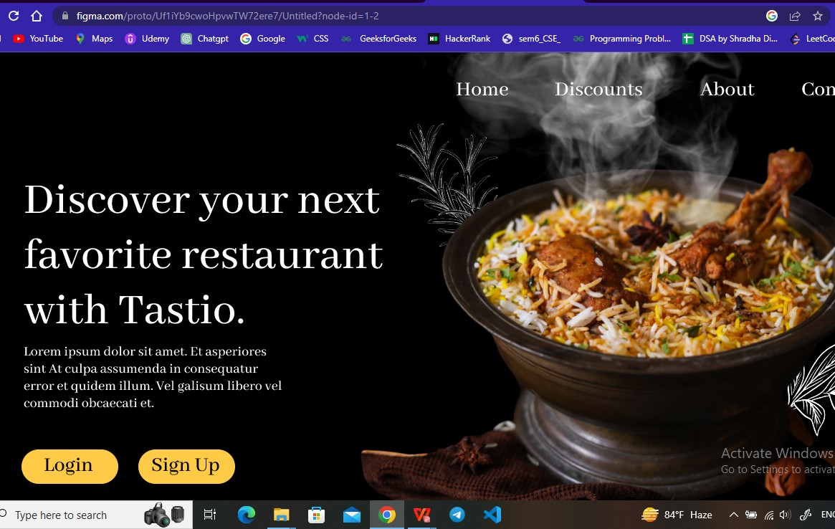
Proposed UI

Slide 17

Conclusion
So this machine learning model will recommend the best restaurant in Kolkata according to the customer’s preference so that customer can spend more time on food and less time trying to find the best restaurant.

Slide 18

Thank You

